Slide 1
Restaurant Location Recommender

Slide 2
Problem Statement
A large hospitality service provider wants to open a new restaurant.
They have restaurants all over the US and want to determine the most strategic location to open a new restaurant.
The demographics of a city may have a significant affect on the performance of the restaurant in addition to the quality of the restaurant itself.
The task is to analyze major cities in the US to determine which city, and where specifically in the city to open a restaurant.
Finally, a type of restaurant will be recommended based on types of restaurants that may be underrepresented in the community.

Slide 3
Data Acquisition
The potential list of cities is obtained from a Wikipedia page at the following address.
https://en.wikipedia.org/wiki/List_of_United_States_cities_by_population
Additionally, zip codes for each city are obtained by utilizing the API, Zip Code API.
https://www.zipcodeapi.com/
The python package “zipcodes” is also used to update the latitudes and longitudes for each zip code.
Finally, foursquare is used to provide the venue data for each set of coordinates.
https://foursquare.com/

Slide 4
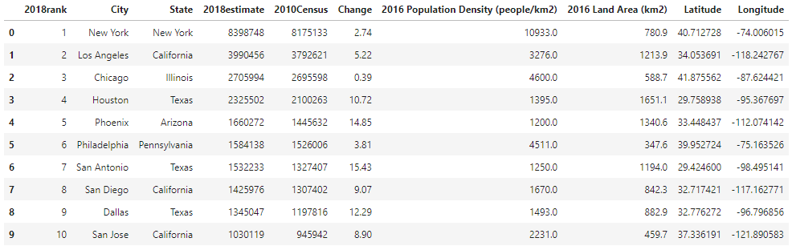
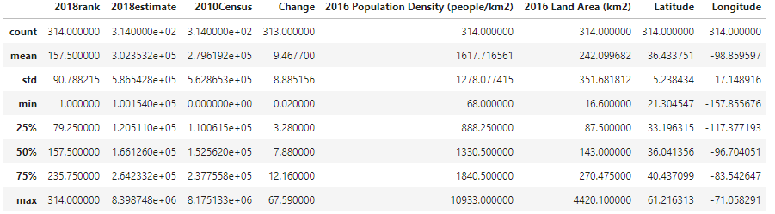
Cleaned City Data and Stats

Slide 5
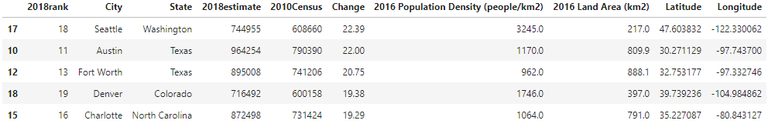
Final Cities for Analysis
Cities were filtered based on 3 criteria
1) Population of at least 500000
2) Population Density above the 25% percentile
3) Top 5 fastest growing cities

Slide 6
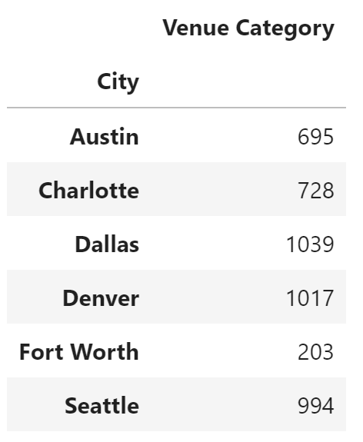
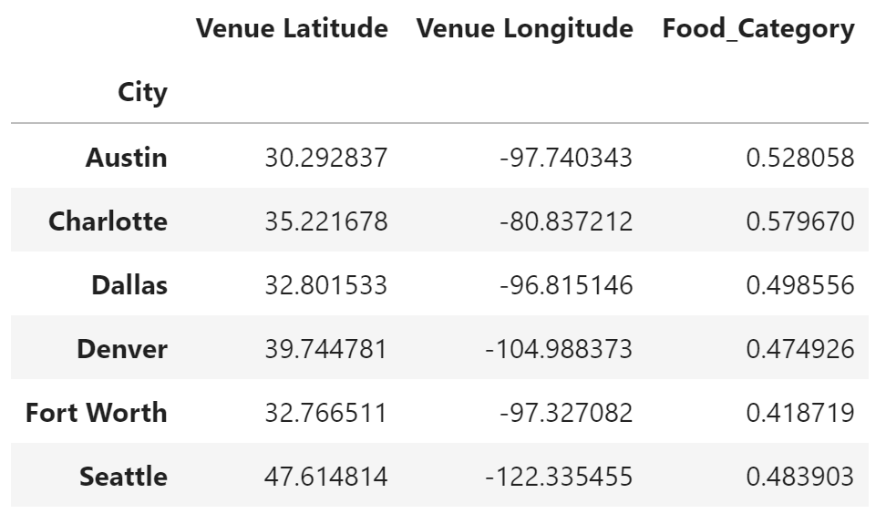
City Venue Stats
Analyze total venues per city and what percentage of venues for each city are food related venues.
City with the percentage of food related venues will be the target city.
Fort Worth is selected as the target city.

Slide 7
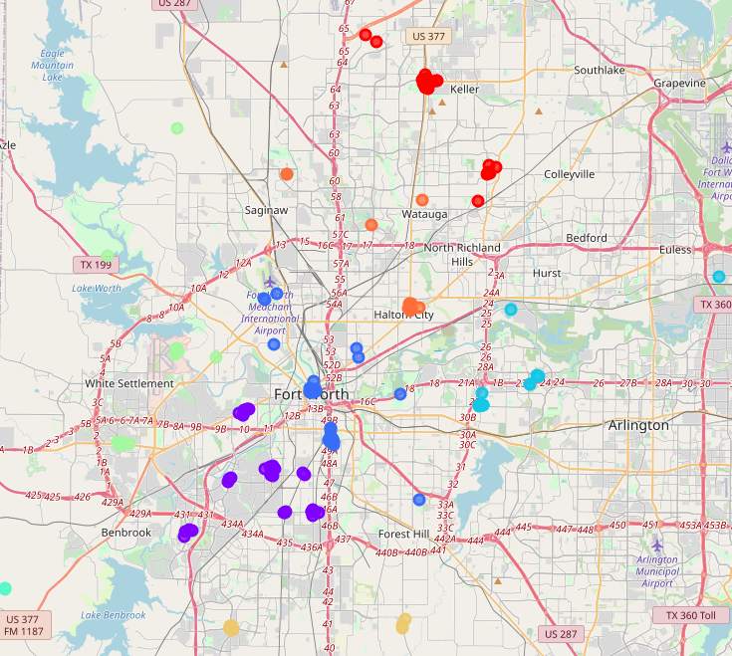
Fort Worth Venue Cluster Visualization
Venues classified into 8 different clusters.
The 5 clusters near the city center will be considered for the location of the restaurant.
The colors of these clusters are light green, purple, blue, light blue and orange.

Slide 8
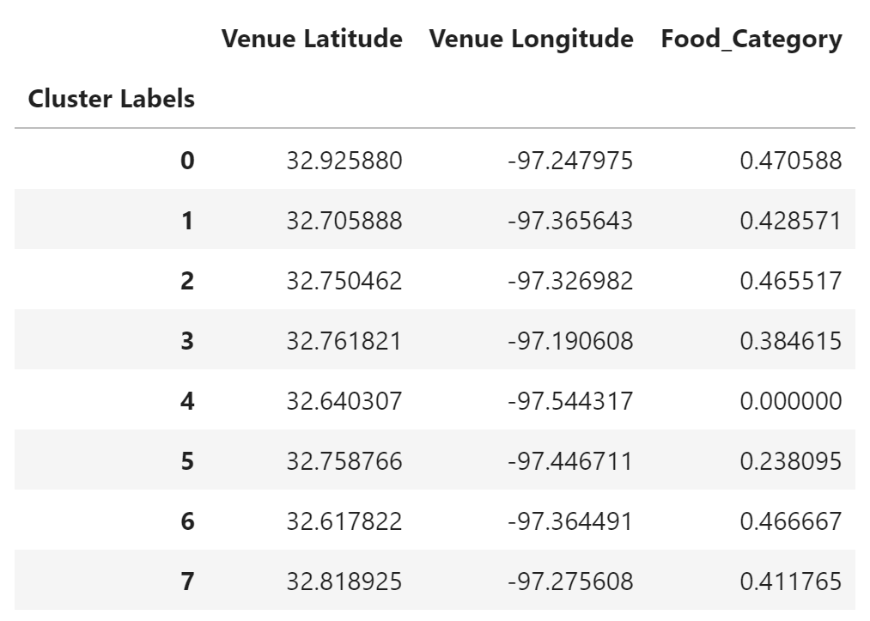
Cluster Selection
Clusters 1, 2, 3, 5 and 7 were considered for the location.
Cluster 5 contains the lowest concentration of food related venues.
Cluster 5 is chosen as the location for the new restaurant.

Slide 9
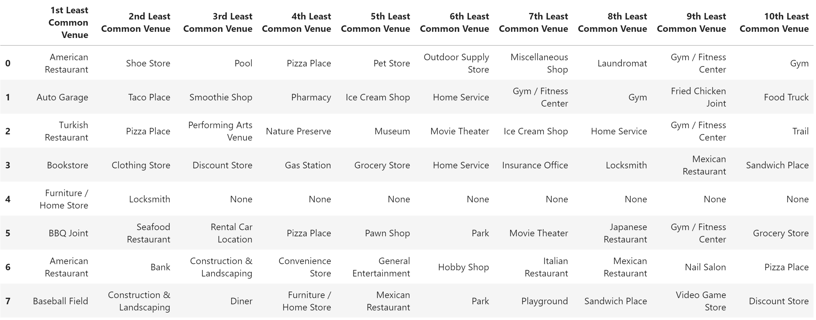
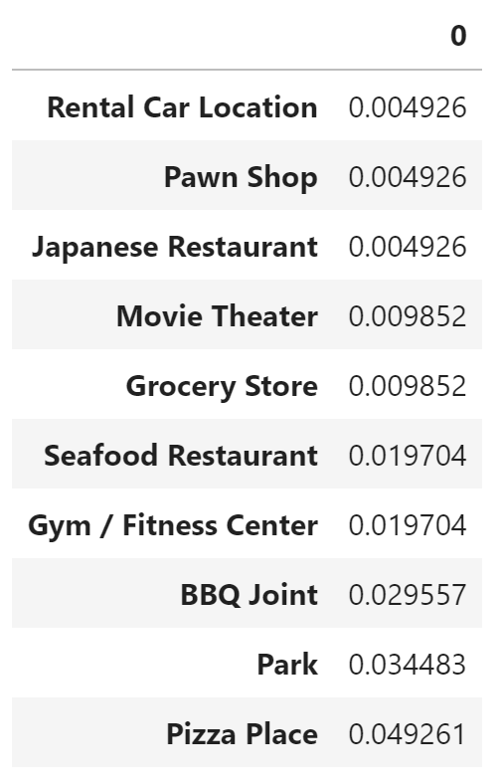
Restaurant Recommendation
The table on the left contains the least common venues for each cluster.
The table on the right contains the least common venues for cluster 5 categorized by their frequency among all venues in Fort Worth.
Japanese Restaurants had the lowest frequency among the food related venues.

Slide 10
Conclusion
Based on the analysis conducted, the recommendation is to build a Japanese Restaurant in Fort Worth located in Cluster 5.
Cluster 5 comprises the following zip codes: 76114, 76116, 76135, 76179, and 76127.

